Slide 1
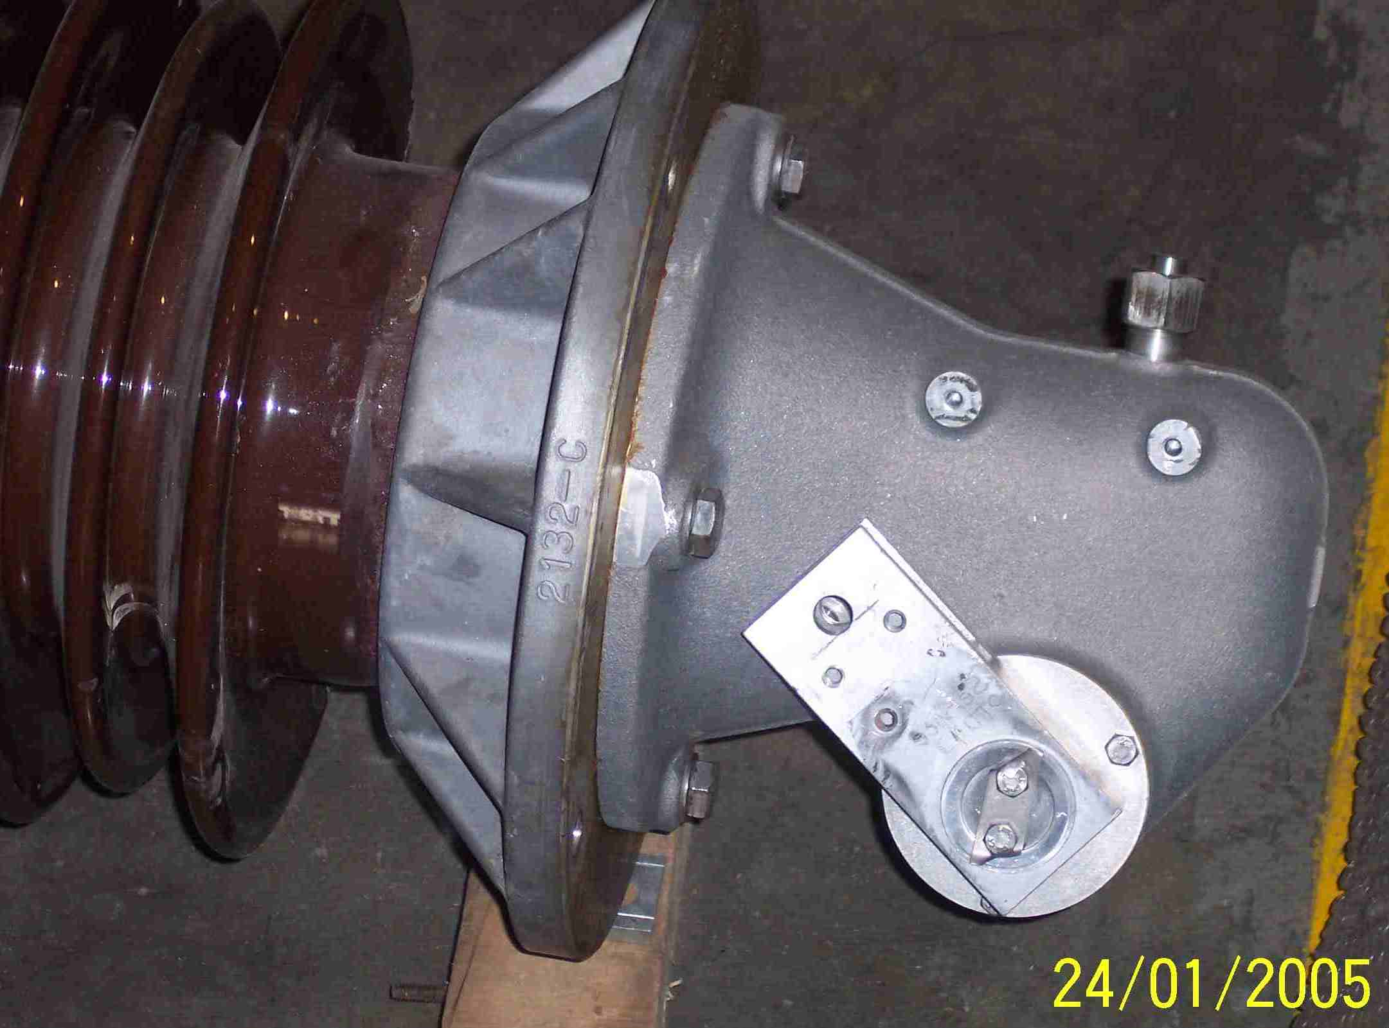
SIEMENS
HVCB SPARES
Gear Box Housing for CB
72.5KV, 31.5KA CB
S4809150001

